Slide 1
Chapter 3 Objectives
The CCNA Topics Covered in this chapter include:
  Layered Models
  The OSI Reference Model
  Functions of each layer
  Half-duplex and Full-duplex
  Data Encapsulation

Slide 2
Layered Models
The Layered Approach
A reference model is a conceptual blueprint of how communications should take place.
It addresses all the processes required for effective communication and divides these processes into logical groupings called layers.
When a communication system is designed in this manner, it’s known as layered architecture.

Slide 3
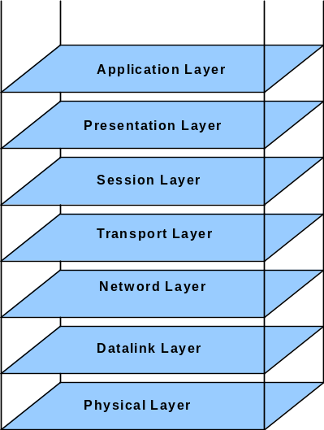
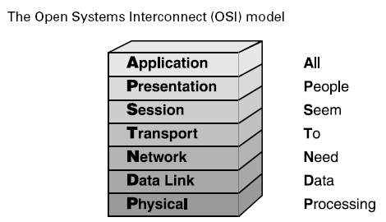
OSI (Open System Interconnection) Model
It is a reference model designed by International Organization for Standardization (ISO) in 1974
OSI is a standard description for how messages should be transmitted between any two points in a telecommunication network
i.e, It describes how Data and Network Information are communicated From an Application on one computer, through the network media, to an Application on another computer
Its purpose is to guide product implementers so that their products will consistently work with other products

Slide 4
General View….
We use the concept of layers in our daily life. As an example, let us consider two friends who communicate through postal mail. The process of sending a letter to a friend would be complex if there were no services available from the post office.

Slide 5

Tasks involved in sending a letter

Slide 6
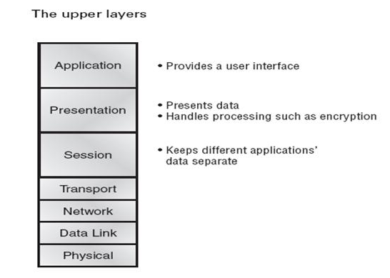
The top 3 layers of the OSI model are referred to the "Upper" layers. These layers are responsible for applications communicating between hosts. None of the upper layers know anything about networking or network addresses.

Slide 7
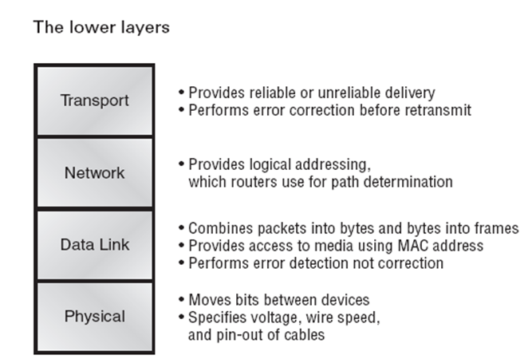
The Last four layers define how data is transmitted end-to-end

Slide 8
Application Layer
The top (seventh) layer of the OSI Reference Model is the
application layer.
It provides the user interface.
Examples of application layer protocols
  Telnet
  File Transfer Protocol (FTP)
  Simple Mail Transfer Protocol (SMTP) and
  Hypertext Transfer Protocol (HTTP)‏

Slide 9
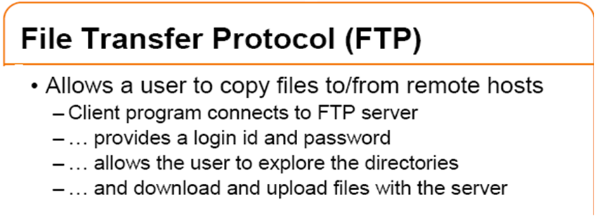

Slide 10
Telnet
The Telnet service allows users to act as though their terminals are attached to another device. This process is referred to as terminal emulation.
Telnet is a very useful protocol in internetworking because it allows network administrators to view and configure remote devices in the network from one location.
Telnet uses the services of TCP to provide a connection-oriented session.
Telnet uses port 23.

Slide 11
Simple Mail Transfer Protocol (SMTP)
SMTP is used to pass mail messages between devices.
It uses TCP connections to pass the email between two mail servers. SMTP uses port 25.
More specifically, SMTP is what allows email to get from the mail client to the mail server, whereas POP3 or Post Office Protocol is a protocol for storage of email.
POP3 is like mailbox or post office box where as SMTP is a protocol for sending and receiving emails.

Slide 12
Simple Network Management Protocol (SNMP)
SNMP is used to obtain data on remote devices, such as a configurable switch.
Typically, a network-management station uses SNMP to poll the devices in a network and to retrieve data regarding the devices' current and past conditions.
It is used mostly in network management systems to monitor network-attached devices
SNMP has become the de facto standard for device management and is widely used today.

Slide 13
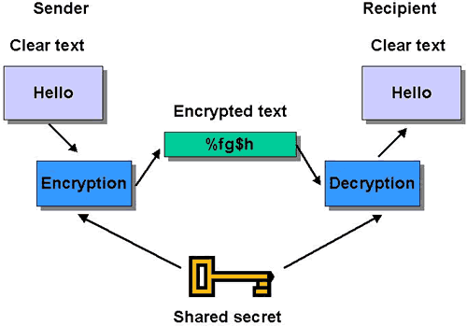
Presentation Layer
The presentation layer determines how data is represented to the user.
Examples of presentation layer protocols and standards include ASCII,
BMP, GIF, JPEG, WAV, AVI, MP3, doc, txt, ppt and MPEG.
  Following tasks are performed in Presentation Layer
  Encoding – Decoding
  Encryption – Decryption
  Compression – Decompression

Slide 14
Session Layer
    Session Layer is responsible for establishing, maintaining and terminating session
    It coordinates communication between systems, and serves to organize their communication by offering three different modes: simplex, half duplex, and full duplex.
    Example: Same HTTP (web) application connecting to different servers.

Slide 15
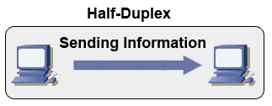
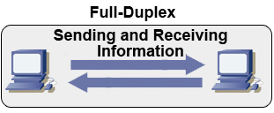
Half Duplex (CSMA/CD)
Unidirectional data flow
Higher potential for collision
Hubs connectivity
Full Duplex
Point-to-point only
Requires full duplex support on both ends
Collision free

Slide 16
Transport Layer
Transport Layer provides both guaranteed data delivery and no guarantee of data delivery.
Examples of transport layer protocols
  Transmission Control Protocol (TCP)
  User Datagram Protocol (UDP)
TCP
TCP provides a connection-oriented, reliable service to the applications that use its services. TCP was designed to add some reliability into the world of IP networking.
UDP
The primary purpose of UDP is to broadcast messages over a network. UDP simply receives data from the Application layer, applies the proper header, and sends the datagram on its merry way. This is why UDP is referred to as a best-effort protocol.

Slide 17
Network Layer
Network Layer is responsible for providing best path for data to reach the destination
Provides logical addressing that routers use for path determination
Internet Protocol (IP) is an example of Network Layer protocol
Packet forwarding
Packet filetering
Makes “Best Path Determination”
Fragmentaion
End-to-end delivery ( Source-to-destination)
Router works in this layer

Slide 18
Data Link Layer
Performs Physical Addressing
This layer provides reliable transit of data across a physical link.
Combines bits into bytes and bytes into frames.
Access to media using MAC address
Error detection, not correction
LLC and MAC
Logical Link Control performs Link establishment
MAC layer deals with the hardware address of LAN card (NIC card),
which is hard coded and can’t be changed. It is unique for every lan card.
Examples of data link layer protocols and standards include IEEE’s 802.2, 802.3, Ethernet II, HDLC, PPP, and Frame Relay.
Switch, Bridge and NIC work in this layer

Slide 19
Physical Layer
The Physical layer defines all the electrical and physical specifications for devices
Physical Layer defines techniques to transfer bit stream to cable.
At the Physical layer, data are transmitted using the type of signaling supported by the physical medium:
electric voltages
radio frequencies
pulses of infrared or ordinary light
Examples: Co-axial cables, Twisted-wire, Optical fibres, Ethernet cable (RJ-45), copper cables, wireless etc...
Hub works in this layer
ABC→0100111
0100111→ABC
0100111
Physical Layer
Physical Layer

Slide 20
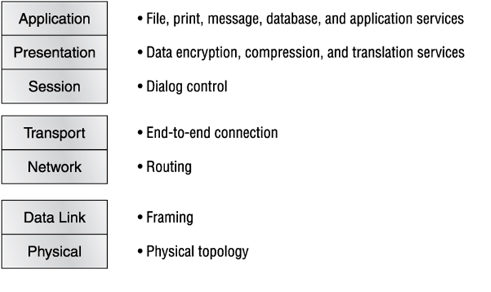
The OSI Model
The Layer Functions

Slide 21

Data Encapsulation
Application
Presentation
Upper-Layer Data
Session
Transport
Segment
TCP Header
Upper-Layer Data
Network
Packet
IP Header
Data
LLC Header
Data
FCS
Data-Link
Frame
MAC Header
Data
FCS
Physical
Bits
0101110101001000010

Slide 22
Data Encapsulation
When a host transmits data across a network to another device, the data goes through encapsulation:
It is wrapped with protocol information at each layer of the OSI model.
Each layer communicates only with its peer layer on the receiving device.

Slide 23
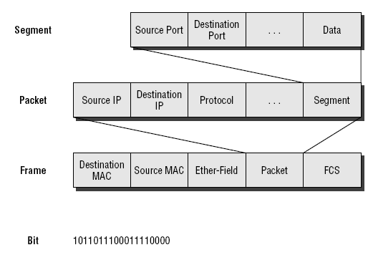
Data Encapsulation

